Slide 1
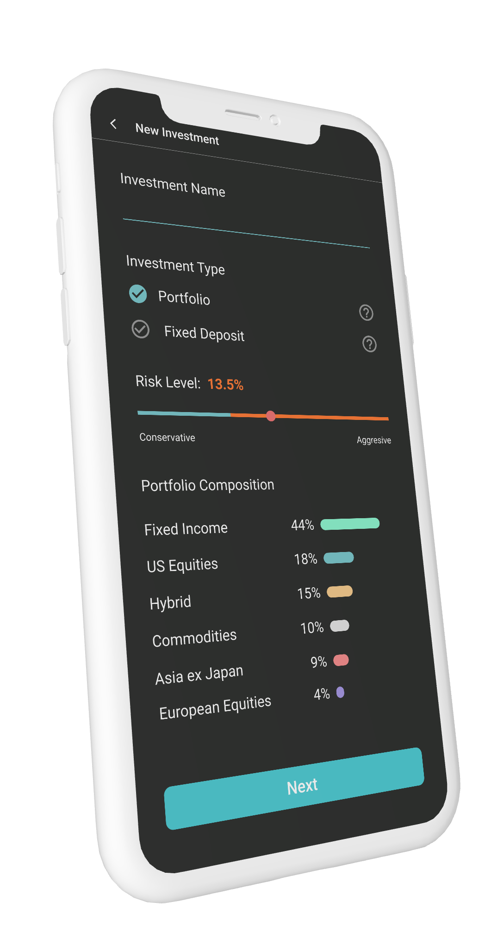
CTRL
YOUR FINANCES
Presented by Team CTRL-ALT-ELITE
Liew Xi Wei (Claire) | Year 1, School of Information Systems (SIS)
Liu Enqi | Year 1, School of Business (LKCSB)
Liu Hongying | Year 1, School of Business (LKCSB)
Notes:
Hi everyone! We are team Ctrl-Alt-Elite, a group of Year 1 students from the School of Information Systems and School of Business. Today, we’ll be presenting our application - Ctrl Your Finances.

Slide 2
THE
PROBLEM STATEMENT
Information is generated at a pace faster than ever before but the signal is often lost amongst the noise. The ability to process large volumes of data quickly and correlate between events in near real time is a crucial competitive advantage in helping you manage your personal finances. Leveraging AWS’ cloud platform and product offerings, you will be designing, implementing and delivering a system to help your peers steer their finances to safe harbors.
In 2016, The Straits Times reported that as many as 2 in 3 young people have not started investing with the lack of financial knowledge being cited as one of the key reasons. As financial information is becoming increasingly accessible and more diverse in nature, it is important that youths have the access to the right information to help facilitate an apt investment plan for retirement. Your task is to design a solution on a platform of your choice, mobile or web, that empowers youths to make smart decisions with their finances by recommending ways and means to
make their money work for them.
The solution should target youths with emphasis in helping them make sense of the labyrinth of financial information available out there and how this information can guide them in making smart decisions.
Notes:
With information generated at a pace faster than ever before, processing large volumes of data has become all the more pertinent. We aim to specifically target the huge amounts of financial information available, sieving out the most pertinent parts to guide youths in making informed financial decisions.

Slide 3
PROPOSED SOLUTION
Mobile Application: All-in-One Saving, Banking & Investing
Financial Literacy Information
+
Saving Goals
+
Portfolio & Group Investment
Bite-sized information
Under “Learn” tab
Charts: progress towards goals
Points-based system to reward
Higher returns on pooled assets
Referral system: higher rates on deposits
Notes:
In view of this problem, we are proposing an all-in-one saving, banking and investing mobile application, ‘Ctrl Your Finances’. [Click] From financial knowledge to [Click] real-time savings, [Click] customized portfolio and group investment, our application truly has it all. [Click] Under the dedicated ‘Learn’ tab, users will be exposed to bite-sized financial literacy information. [Click] Beginning your savings with actionable goals, our application charts clear progress towards your goals, with a points-based system to reward users as they complete more and more goals.
Looking into investing but don’t know where to start, or worried about not having enough initial sum to reap significant returns? These are common investment problems faced by youths today. But with CTRL, we’ve got all these covered. [Click] Beyond basic robo-advisory services, our portfolio and group investment feature allows users to pool money with friends and invest together, yielding higher returns. Utilising advanced smart contract and blockchain technologies, our application ensures returns on these pooled assets are safe for all individuals - even in the event of a couple break up. For higher rates and returns on deposit savings, users can simply send the referral code along to their friends. The more friends referred, the higher the returns on deposits.

Slide 4
COMPETITIVE ANALYSIS
A Comparison of Our Services vs Current Market Offerings
 | CTRL (Our Solution) | StashAway (Robo-advisors) | iBanking Apps | Seedly (Articles, Forums) | Habitica (Game-Based Productivity)
FinLit Information
✓
✓
✓
✓
✘
Goal-Based Approach
✓
✓
✓
✘
✓
Points System
✓
✘
✘
✓
✓
✓
✘
✘
✘
✘
Group Portfolio Management
✓
✘
✘
✓
✘
Discussion Forums
Notes:
Looking across existing market solutions, CTRL easily provides users with the most comprehensive suite of offerings. With [Click] access to live repository of financial information from the Yahoo Finance API, [Click] goal-based approach for users to easily track spendings, savings and investment goals, CTRL equips users with the necessary knowledge and platform to effectively manage their personal finances, and achieve concrete steps towards long-term goals.
[Click] With a points-based system to reward users for completing their goals, and a weekly leaderboard ranking against friends, CTRL ensures that users are incentivized, and kept accountable for financial goals in the long run. [Click] The group portfolio management feature also allows users to pool and invest their assets with friends to enjoy higher returns. [Click] Discussion forums further this community approach, allowing users to approach a ready community for help anytime.

Slide 5
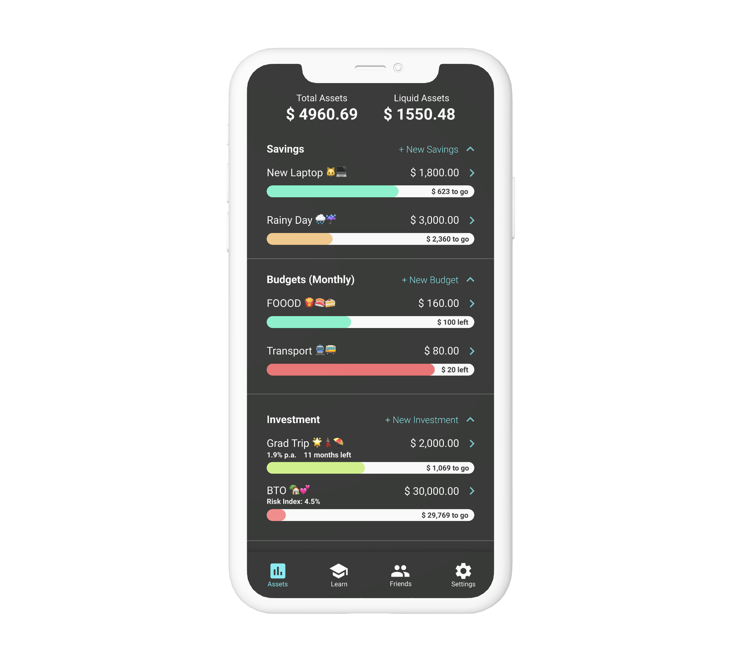
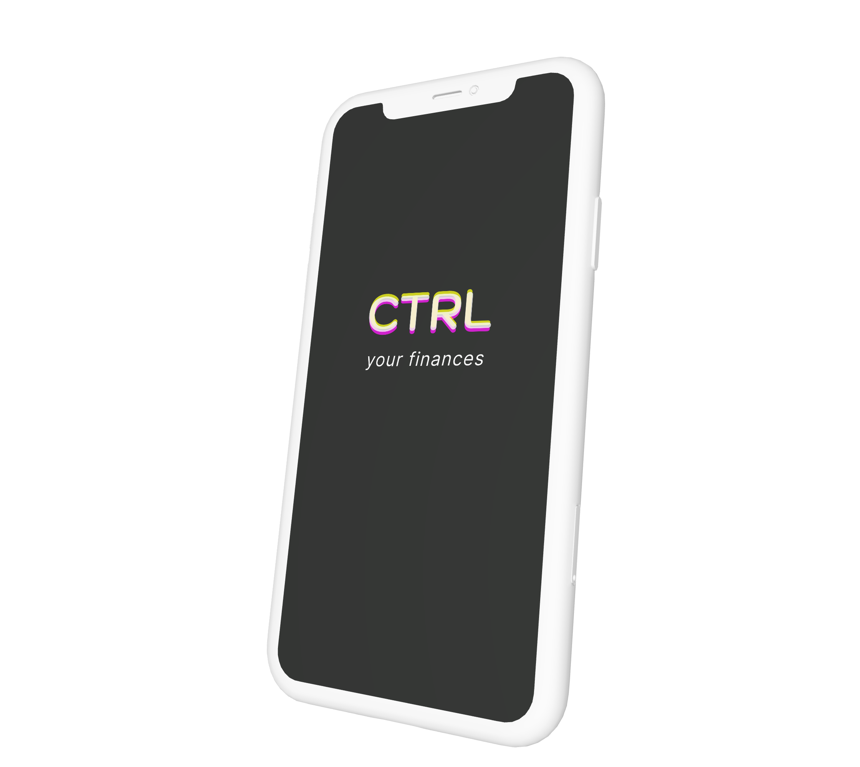

BUILT SOLUTION
LINK: https://bit.ly/2FdsTa6t
Notes:
Here is a live demonstration of our mobile application, ‘Ctrl’. [CLICK] The sleek and matte UI design, coupled with an intuitive UX and a comprehensive suite of services - easily increases our appeal to youths of all needs.
The ‘Assets’ tab provides an overview of the user’s current portfolio - providing a quick snapshot of the user’s assets. Clicking onto these individual fields allows users to easily create new savings, budgets, insurance or even investments with our robo-advisory platform, within the click of a button. Specifically, our investment platform allows youths to pool their assets together, opening their doors to invest in funds that require a minimum deposit.
The ‘Learn’ tab then provides users with necessary financial literacy knowledge, alongside community discussion forums for users to clarify any doubts they may face. The ‘Friends’ tab allows users to easily find and add other users as friends, tracking the achievement of savings goals together, under a ranked leaderboard system.
[Click]
For our MVP, we have implemented saving goals, group investment and the learn page. Our application can be found at the link in the slide here.

Slide 6







SOLUTION ARCHITECT
Key technology / frameworks used
AWS Amplify
AWS DynamoDB
CryptoJS
AWS EC2
Cloud Functions
Mobile Application
Blockchain
Yahoo Finance API
Notes:
Here is an overview of our solution architect and the key technology and frameworks. The front-end of our mobile application is built with React NATIVE, giving us flexibility to provide the app for both iOS and Android phones.
[CLICK] To create a seamless experience, we used AWS Amplify, AWS DynamoDB to store data, such as saving and budget goals.
[CLICK] We also used Blockchain services to create smart contracts for group investments. This ensures pooled assets are safe for all individuals, and penalty will only apply to those who break the contract.
[CLICK] Additionally, real-time financial data is pulled from the Yahoo Finance API, providing users with timely updated information to make informed financial decisions.

Slide 7
KEY BENEFITS + CHALLENGES
BENEFIT #1
BENEFIT #2
BENEFIT #3
Bite-sized financial literacy knowledge
Community and discussion forums for like-minded individuals to connect
All-in-one app provides convenience for a variety of functions (savings, budgeting, portfolio management,)
CHALLENGE #1
CHALLENGE #2
CHALLENGE #3
Promotion of the platform to a suitable target audience
Incentivisation of youths to utilise the platform
Many features available may create a loss of focus as users may prefer a more streamlined app
Notes:
While challenges include [CLICK] publicity, [CLICK] incentivisation of youths, [CLICK] and possible loss of focus, we believe benefits of our holistic solution will ultimately outweigh challenges.
[CLICK] Bite-sized yet comprehensive financial knowledge, [CLICK] community and discussion forums, [CLICK] and an all-encompassing range of services from savings and budgeting to portfolio management, will cater to youths at all levels of financial literacy knowledge and needs.

Slide 8
IMPLEMENTATION TIMELINE
Points reward system for user leaderboard ranking
Interactive Discussion Forum
Insurance tracking
Phase 1: MVP
Phase 3: Suite
> > >
> > >
Assets Summary
Bite-sized Financial Information from Yahoo Finance API
Community-based Aspect (Friends functionality)
Budgeting / Savings / Investing entry & logging
Phase 2: Midpoint
Implementation of robo-advisor with group portfolio management & investments USP
Notes:
We intend to roll out the full suite of services in 3 phases. [Click] Phase 1, [Click] provides users with a snapshot of their assets, bite-sized financial information from the Yahoo Finance API, and friends functionality under our community-based approach. Under this phase, users can also enter and keep track of their budgeting, savings, and investments.
[Click] In Phase 2, the midpoint phase, [Click] we will implement a complete points system to reward users for completing savings and investment goals. It also comes with an interactive discussion forum, to build a network of close-knit, like-minded users. The insurance tracking component would also come in here.
[Click] In Phase 3, we will complete all features. [Click] Notably, we will roll out our robo-advisor, with the unique selling point of group portfolio management and investment capabilities.

Slide 9
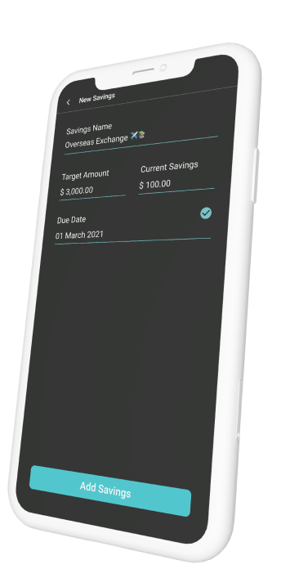
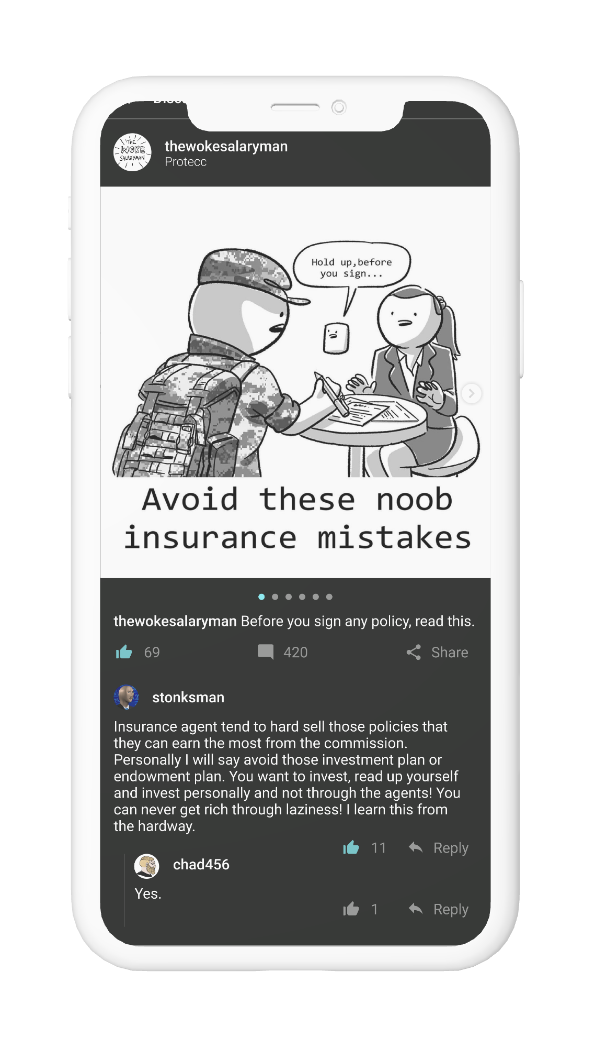
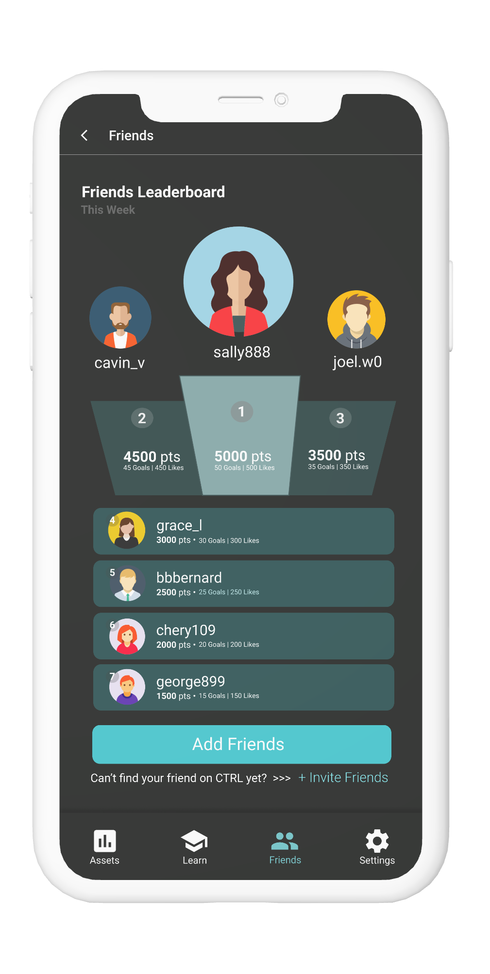
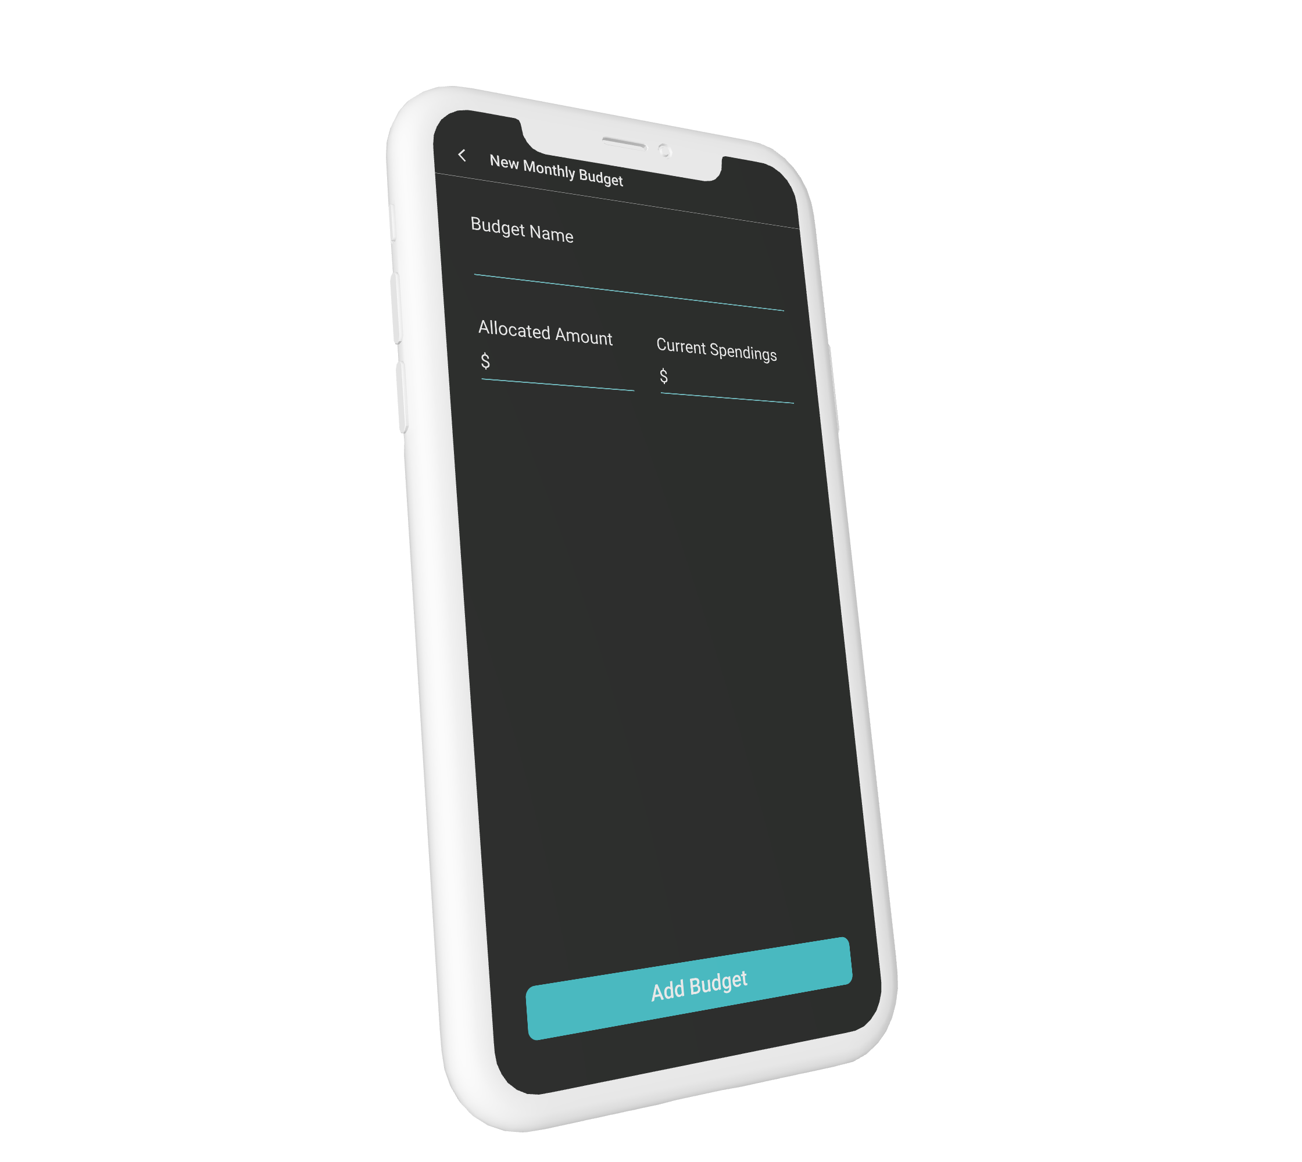
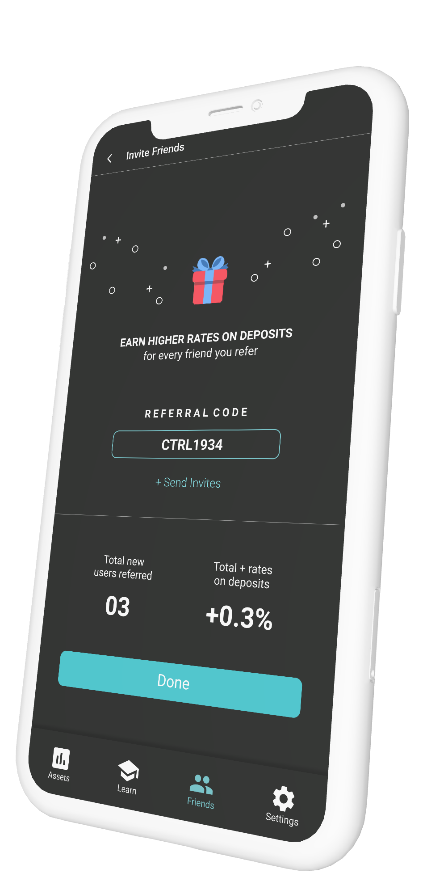
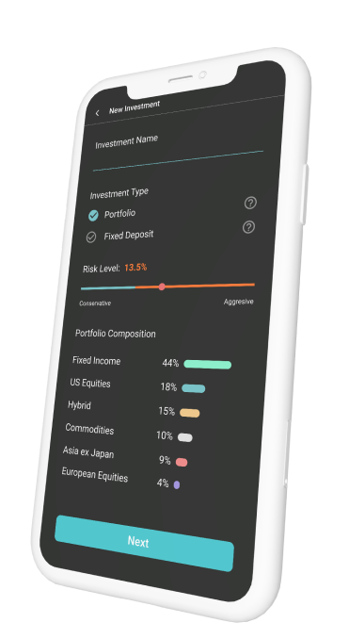
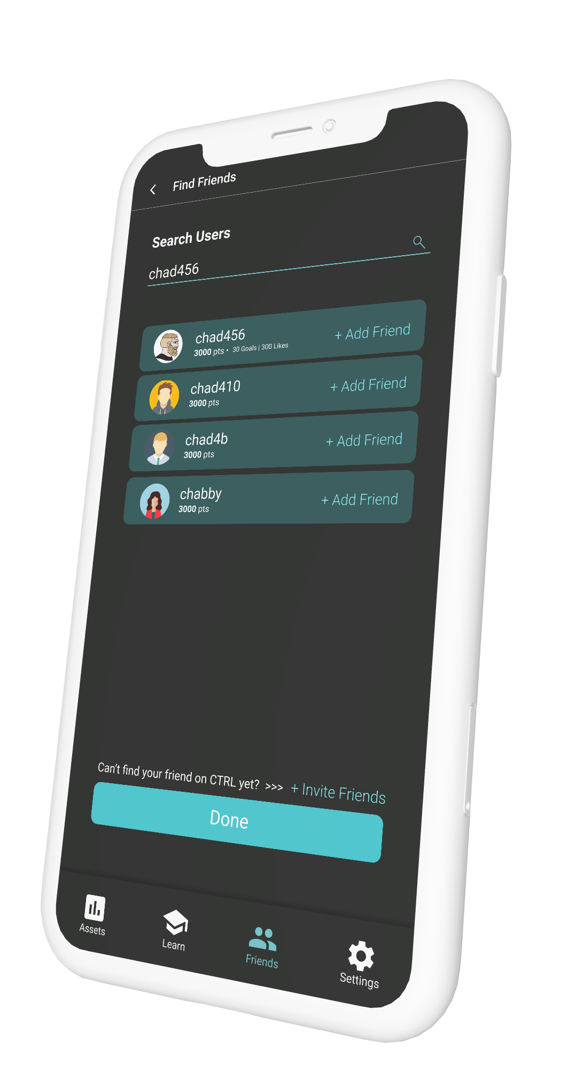
CONCLUSION
Portfolio / Assets Management
Financial Information + Discussions
Friends
Referral
Budgeting
Savings
Investments
Notes:
In conclusion, our application provides a whole suite of functions -- [click] from portfolio and assets management to [click] essential financial information, while integrating community-based aspects such as discussion forum, [click] friends leaderboard platform, and group portfolio investment functionalities. With such a comprehensive range of services, we believe our application, Ctrl Your Finances, would truly appeal to all categories of youths, regardless of their current financial knowledge and needs.

Slide 10
THANK YOU !
Team CTRL-ALT-ELITE
Notes:
And with that, we have come to the end of our presentation. Thank you!

